Slide 1
Summary HPLC Ladder creation and gradient understanding
Constant parameters in all runs:
Waters Xterra MS C18 2.5um 4.6x50mm Column
60⁰C Flow not inside heater
Flow Rate 0.5mL/min
AU 260nm
Goals:
Building a ladder for Oligos 30-60 b.p long
Understanding how run time and percent of ACN concentration effect the separation
Understanding how different assembly of oligos while keeping the same nt length affect the results

Slide 2
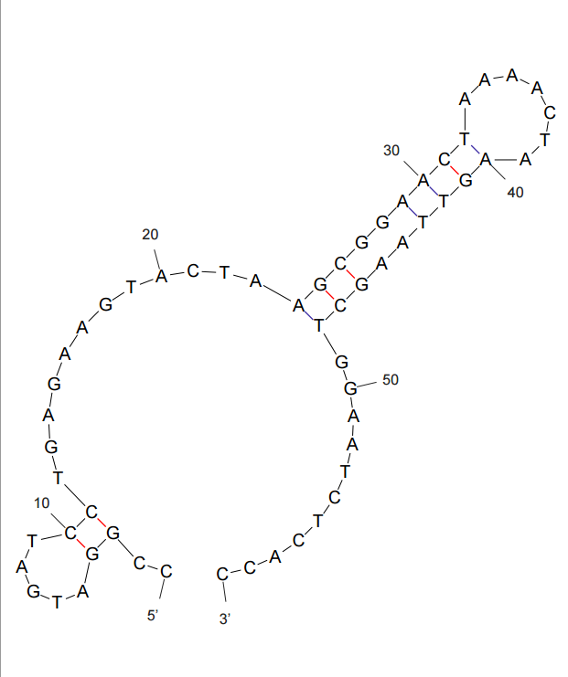
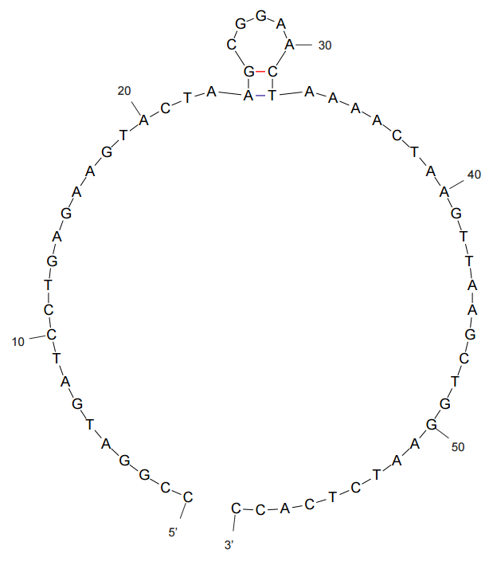
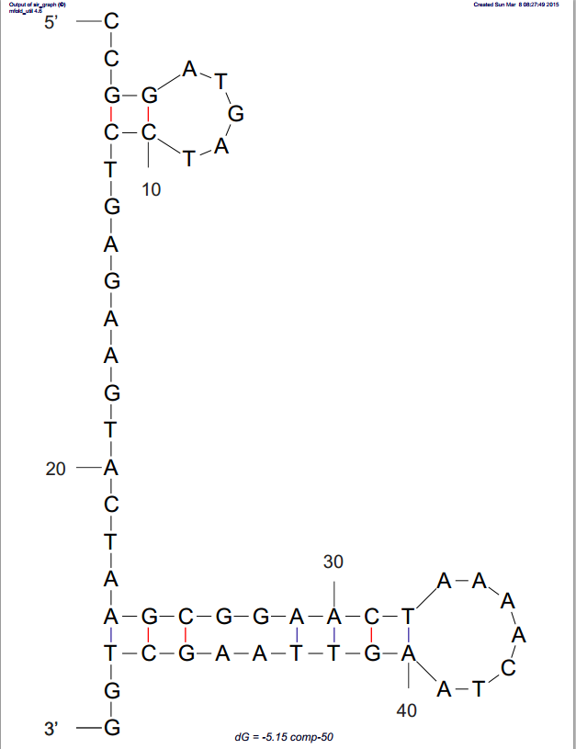
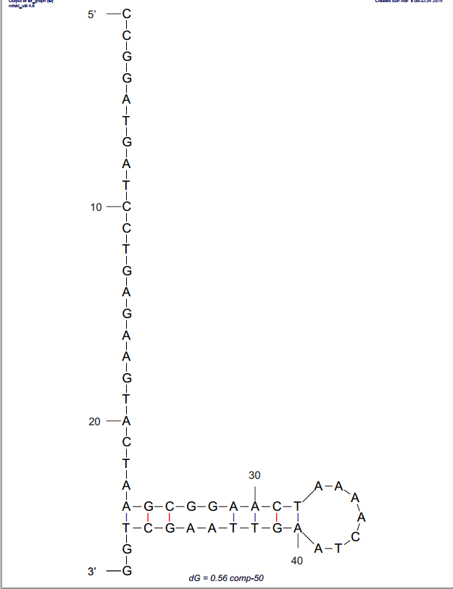
Structures and b.p of 30-60 Ladder Creation
ToeHold-60 | CCGGATGATCCTGAGAAGTACTAAGCGGAACTAAAACTAAGTTAAGCTGGAATCTCACC
comp-50 | CCGGATGATCCTGAGAAGTACTAAGCGGAACTAAAACTAAGTTAAGCTGG
b.p changes in the last 10 of each sequence
ToeHold-60
mFold structure @ 25C
delG=-2.38
comp-50
mFold structure @ 60C
delG=0.56
comp-50
mFold structure @ 25C
delG=-5.15
ToeHold-60
mFold structure @ 60C
delG=1.47

Slide 3
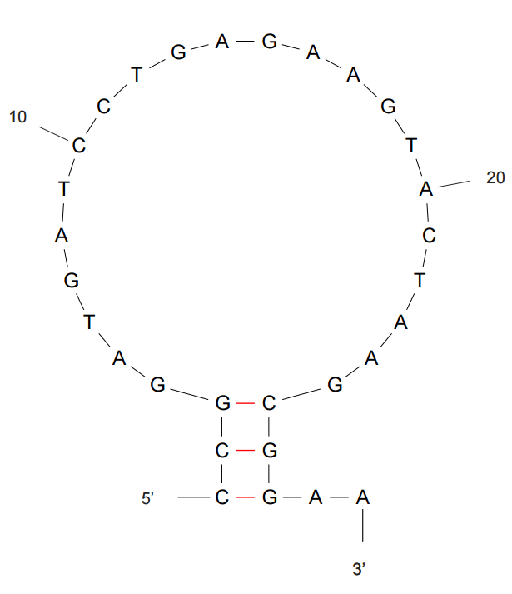
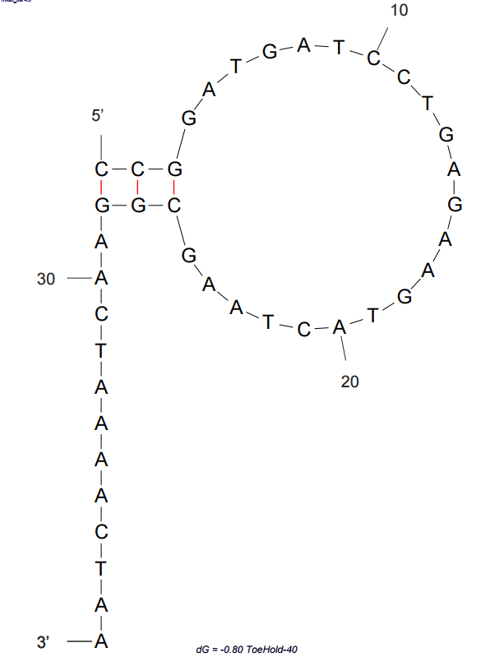
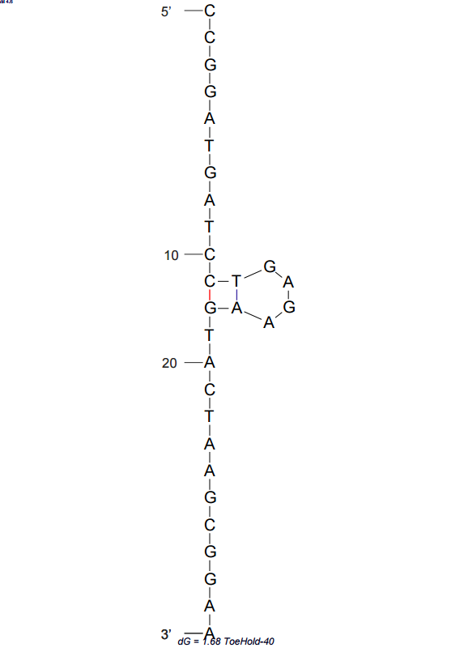
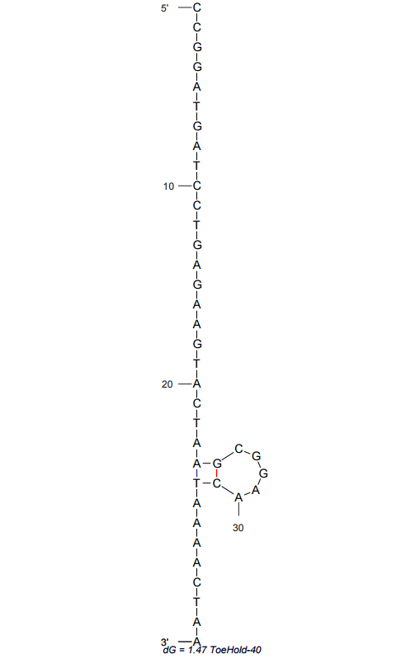
Structures and b.p of 30-60 Ladder Creation
comp-40 | CCGGATGATCCTGAGAAGTACTAAGCGGAACTAAAACTAA
comp-30 | CCGGATGATCCTGAGAAGTACTAAGCGGAA
comp-30
mFold structure @ 60C
delG=1.60
comp-30
mFold structure @ 25C
delG=-0.80
comp-40
mFold structure @ 25C
delG=-0.80
comp-40
mFold structure @ 60C
delG=-0.80

Slide 4
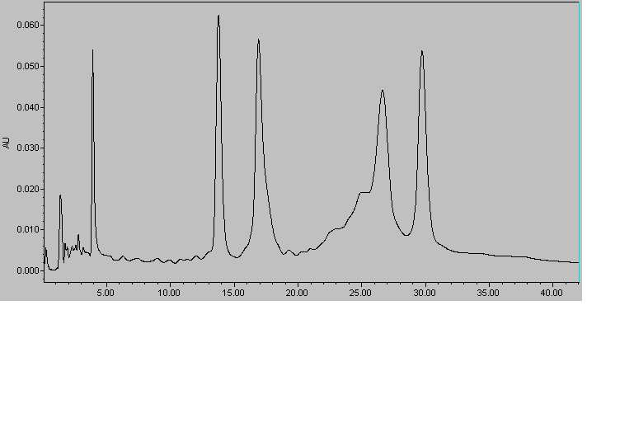
First 30-60 Run
60
Method: LDS
260nm
30
40
50
Big signal to noise disturbnce.
The 50nt oligo is probably disassembled or damaged (old sample), new sample was ordered.

Slide 5
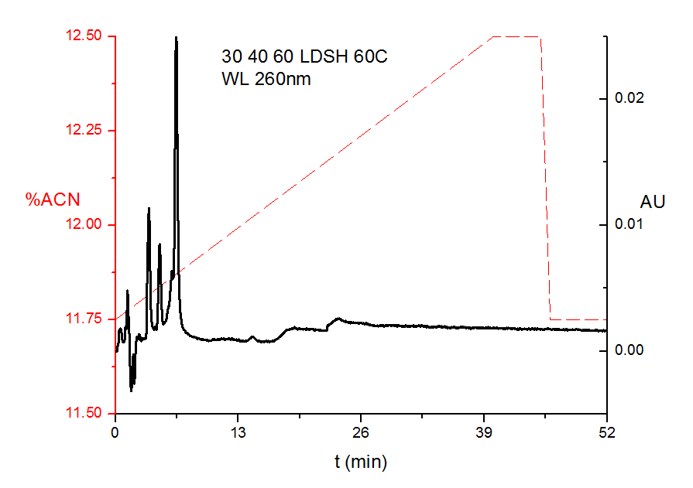
First attempt in changing the gradient, more steep to an higher ACN concentration in less time.
Results are terrible. Unable to determine separation.
First understanding the importance of time vs gradient

Slide 6
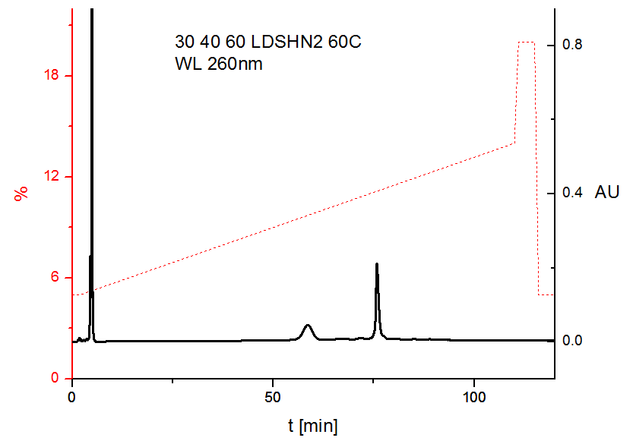
Second attempt in changing gradient. Less steep and to the same ACN concentration
Still bad results. No reproducibility

Slide 7
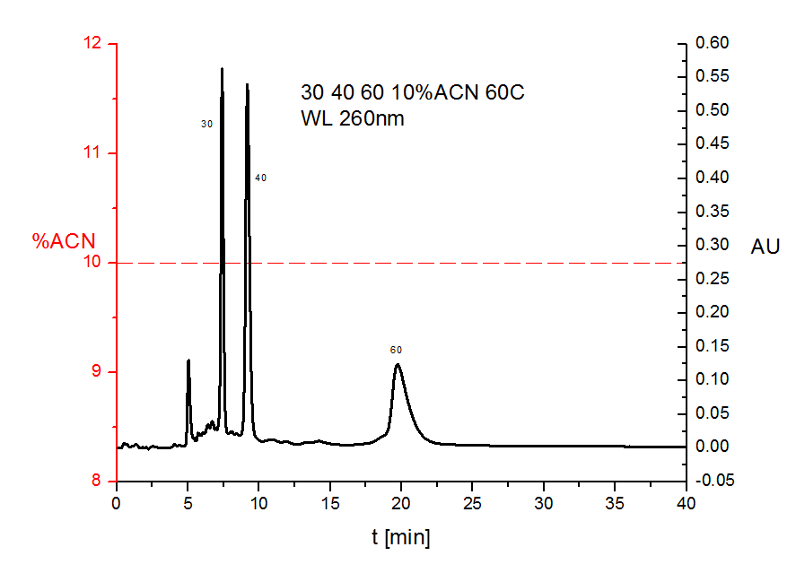
First trial in seeing the effects of run time on the length of the oligos.
Separation is better compered to previous attempts, although reproducibility still not good.
DNA absorption throughout the run

Slide 8
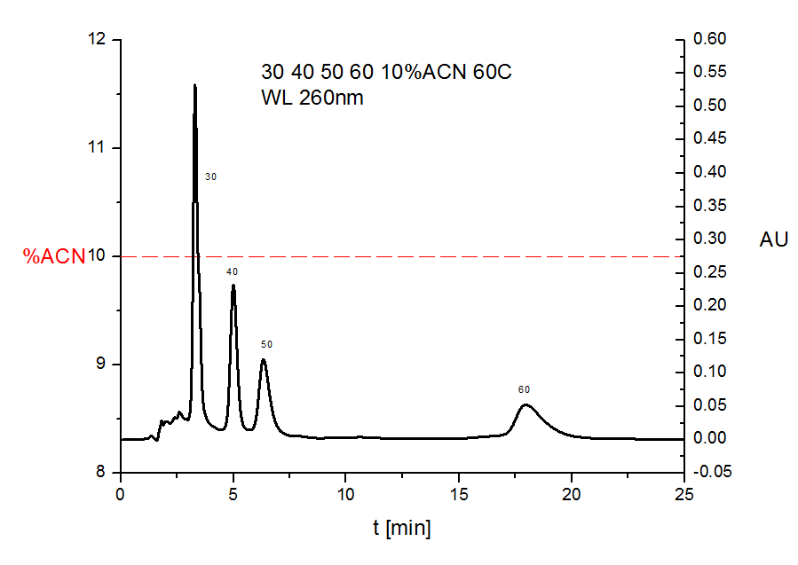
Same run as previous slide with adding the 50nt oligo.
Conclusions are relatively same as last run.

Slide 9
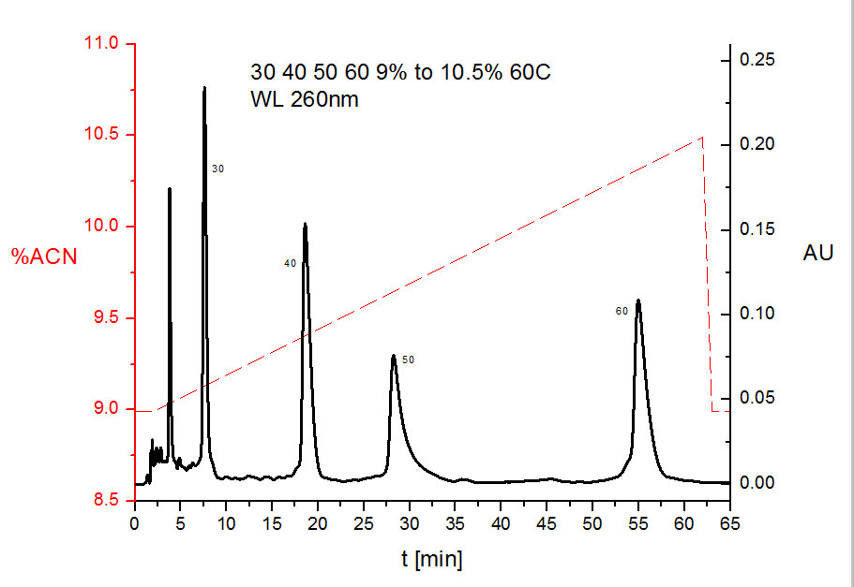
Best gradient so far, oligos exiting at

Slide 10
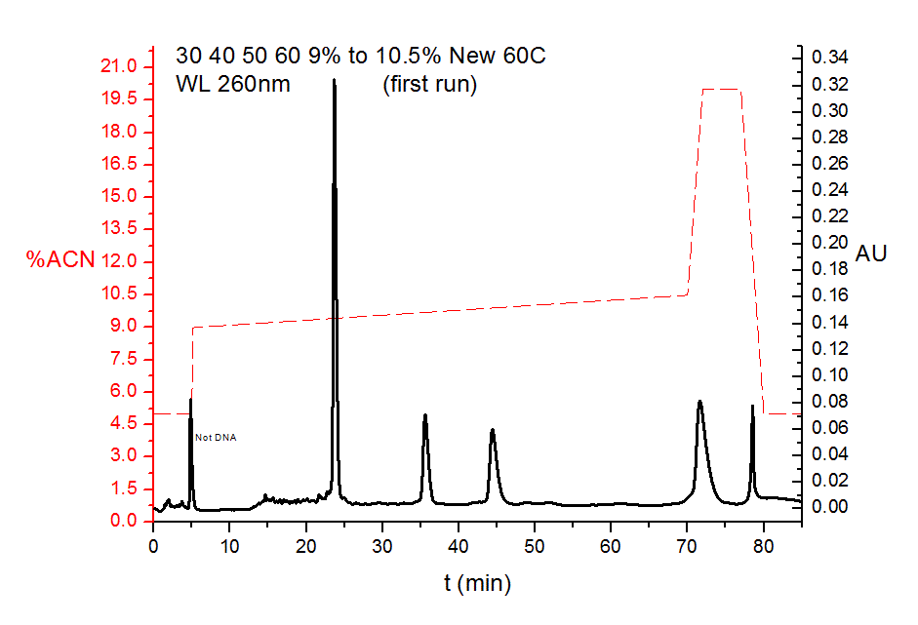

Slide 11
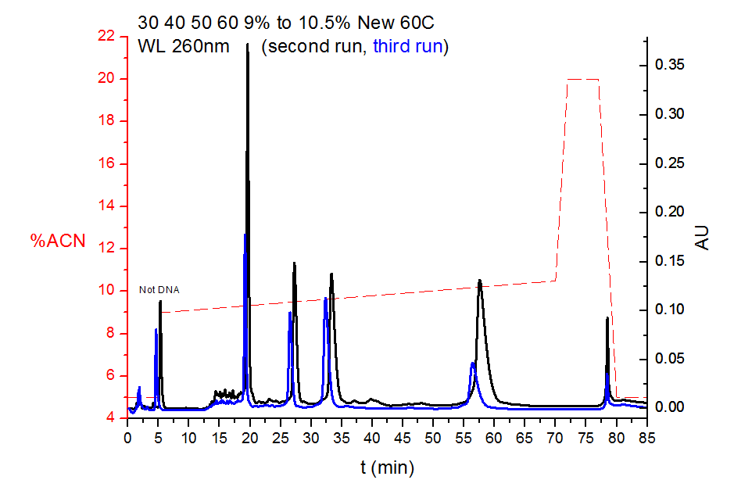

Slide 12
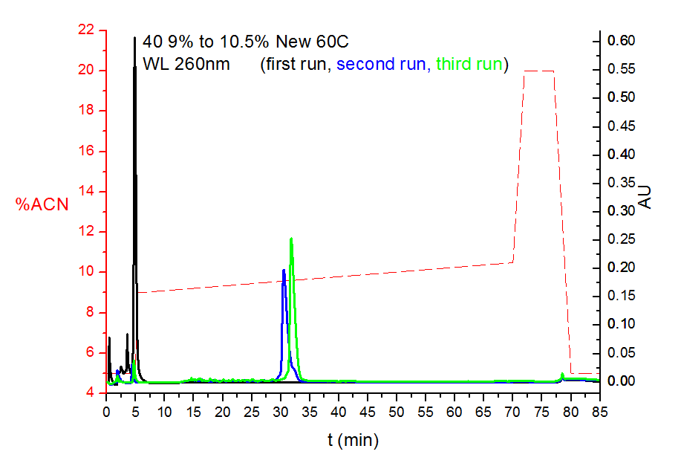

Slide 13
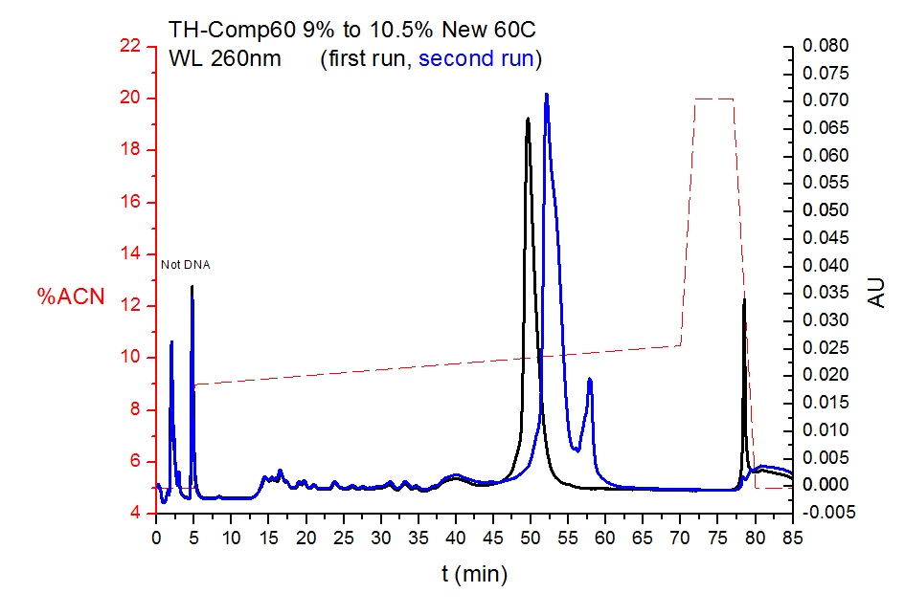

Slide 14
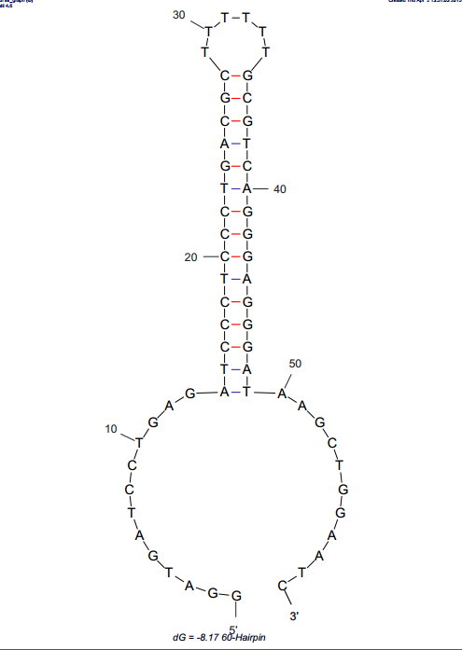
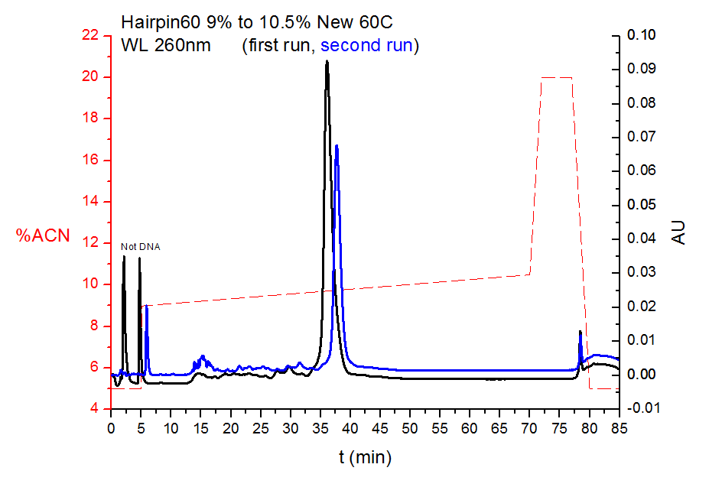
Hairpin60
mFold structure @ 60C
delG=-8.17

Slide 15
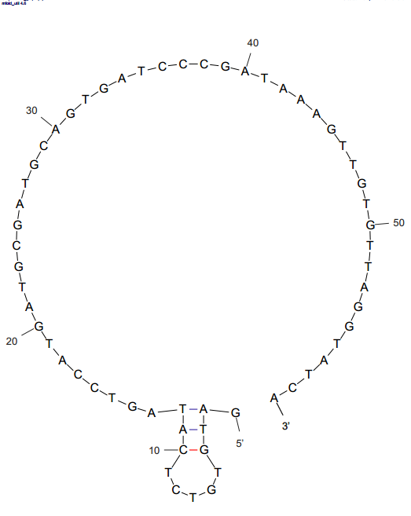
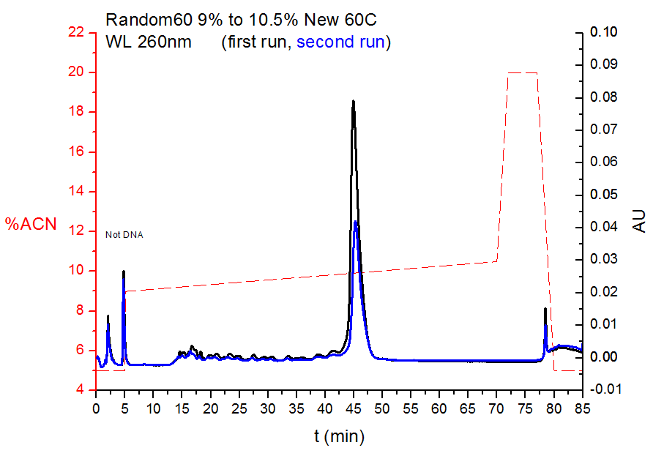
Random60
mFold structure @ 60C
delG=1.87

Slide 16
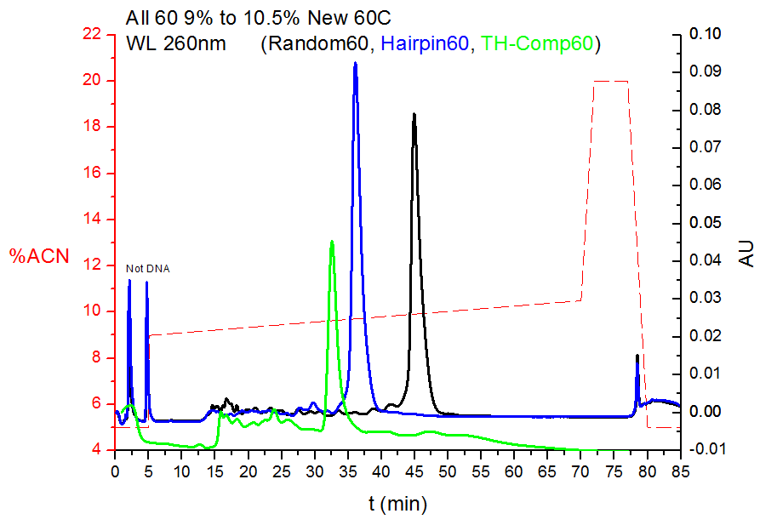

Slide 17
Oligo-RP Column

Slide 18
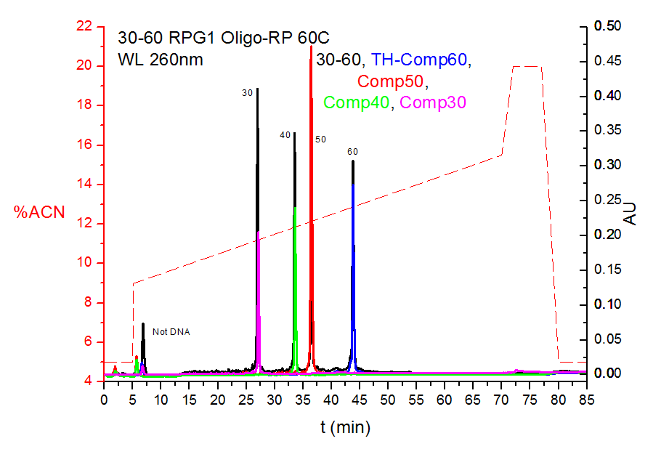

Slide 19
